Slide 1


Student Details
Name: Aritra mondal
SkillsBuild email id. : maritra567@gmail.com
College Name: future Institute of technology
College state: west Bengal
Internship domain & start and end date: [front end development]/[24th June - 31st July]

Slide 2
PROJECT TITLE/Problem Statement
Build a responsive clone website using HTML , CSS and JavaScript.

Slide 3
AGENDA
The agenda for creating the landing and signup pages of a Netflix clone website involves developing a visually appealing and responsive front-end using HTML, CSS, and JavaScript. The landing page will feature a captivating hero section with promotional content, engaging visuals, and call-to-action buttons to entice visitors. This will be followed by sections highlighting the service's features and benefits. The signup page will include a user-friendly form for new users to create accounts, incorporating real-time form validation, interactive input fields, and seamless transitions to enhance the user experience. Both pages will maintain a cohesive design, ensuring brand consistency and an intuitive user journey from landing to signup.

Slide 4
PROJECT OVERVIEW
The Netflix Clone Website project aims to create a visually captivating and functional landing and signup page, replicating the core elements of the popular streaming service's user interface. Using HTML, CSS, and JavaScript, the landing page will feature an engaging hero section, promotional content, and call-to-action buttons designed to attract potential users. The signup page will include an intuitive and responsive form for new users to create accounts, incorporating features such as real-time validation and smooth transitions to ensure a seamless user experience. This project will focus on delivering a polished, user-friendly front-end that highlights the service's value and encourages user engagement.

Slide 5
WHO ARE THE END USERS of this project?
The end users of a Netflix cloning website are primarily individuals who enjoy streaming movies and TV shows online. This includes a broad demographic ranging from teenagers to adults who are looking for an engaging and intuitive platform to discover, watch, and manage their favourite entertainment content. Additionally, the website may attract tech enthusiasts and developers interested in exploring and understanding the implementation of modern web technologies in a streaming service clone.
Characteristics of End Users:
Diverse Age Groups
Tech-Savvy
Entertainment Enthusiasts
On-Demand Preferences
Subscription-Based Users
Needs of End users:
Variety and Quality of Content
User-Friendly Interface
Personalization
Multi-Device
Offline Viewing
Parental Controls
Benefits for End Users:
Convenience
Personalized Experience
High-Quality Streaming
Ad-Free Viewing
Exclusive Content
Cost-Effective
Family-Friendly Options

Slide 6
YOUR SOLUTION AND ITS VALUE PROPOSITION
A Netflix login and signup clone offers the solution of facilitating secure and efficient user authentication and onboarding processes for a streaming platform. The value proposition includes providing a smooth and user-friendly interface for new users to easily create accounts and for existing users to log in seamlessly. This system can incorporate advanced security features, such as multi-factor authentication and encryption, to protect user data. By ensuring a hassle-free and secure login and signup experience, the service enhances user satisfaction, builds trust, and encourages higher engagement and retention rates.

Slide 7
How did you customize the project and make it your own
Customizing a Netflix login and signup page can enhance user experience and security by integrating features such as personalized welcome messages, and social media login options. Adding multi-factor authentication and customizable profile avatars can further improve security and personalization. Implementing a clean, user-friendly design with clear call-to-action buttons and accessibility options like text-to-speech and high-contrast modes ensures an inclusive experience. Progressive disclosure can simplify the signup process, while localized content caters to a global audience. Highlighting promotional offers, using responsive design for various devices, and providing clear error messages can attract and retain users effectively.

Slide 8
MODELLING
Modelling a Netflix login and signup page project involves creating a detailed blueprint that includes user flow diagrams, wireframes, and mock ups to ensure a seamless and intuitive user experience. This project should begin with identifying user requirements and defining key functionalities, such as secure authentication, social media integration, and personalized welcome messages. Wireframes and mock ups should showcase a clean, responsive design optimized for various devices, with clear call-to-action buttons and accessibility features. Additionally, the project should incorporate multi-factor authentication for enhanced security and progressive disclosure to simplify the signup process. Localization and promotional highlights should be planned to cater to a global audience and attract new users. Finally, thorough testing and user feedback loops should be integrated to refine the design and functionality continually.

Slide 9
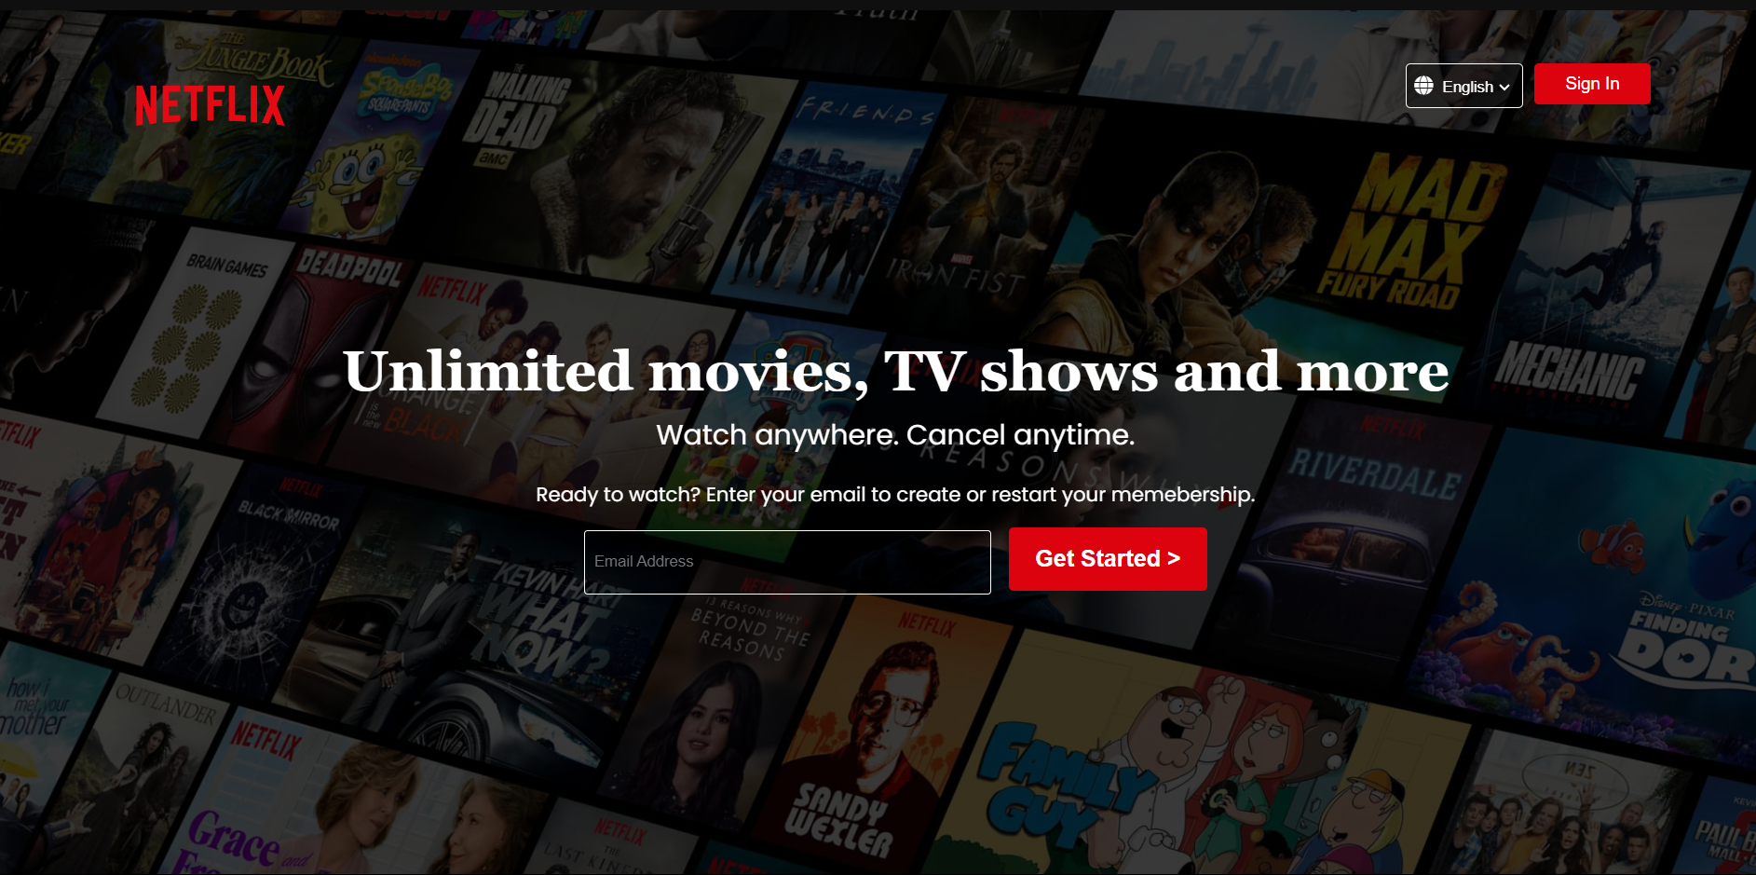
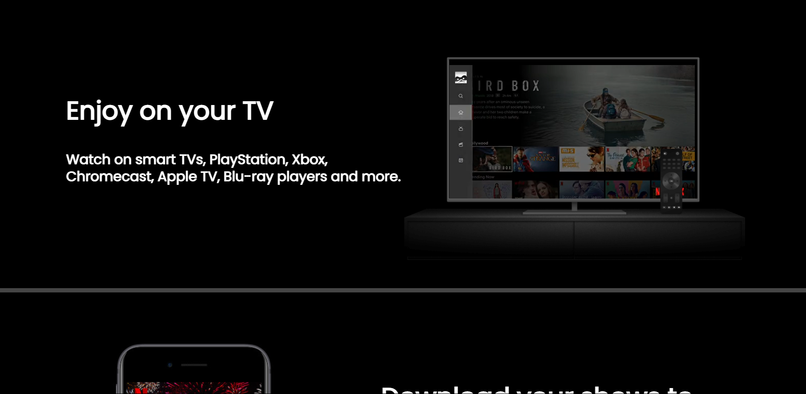
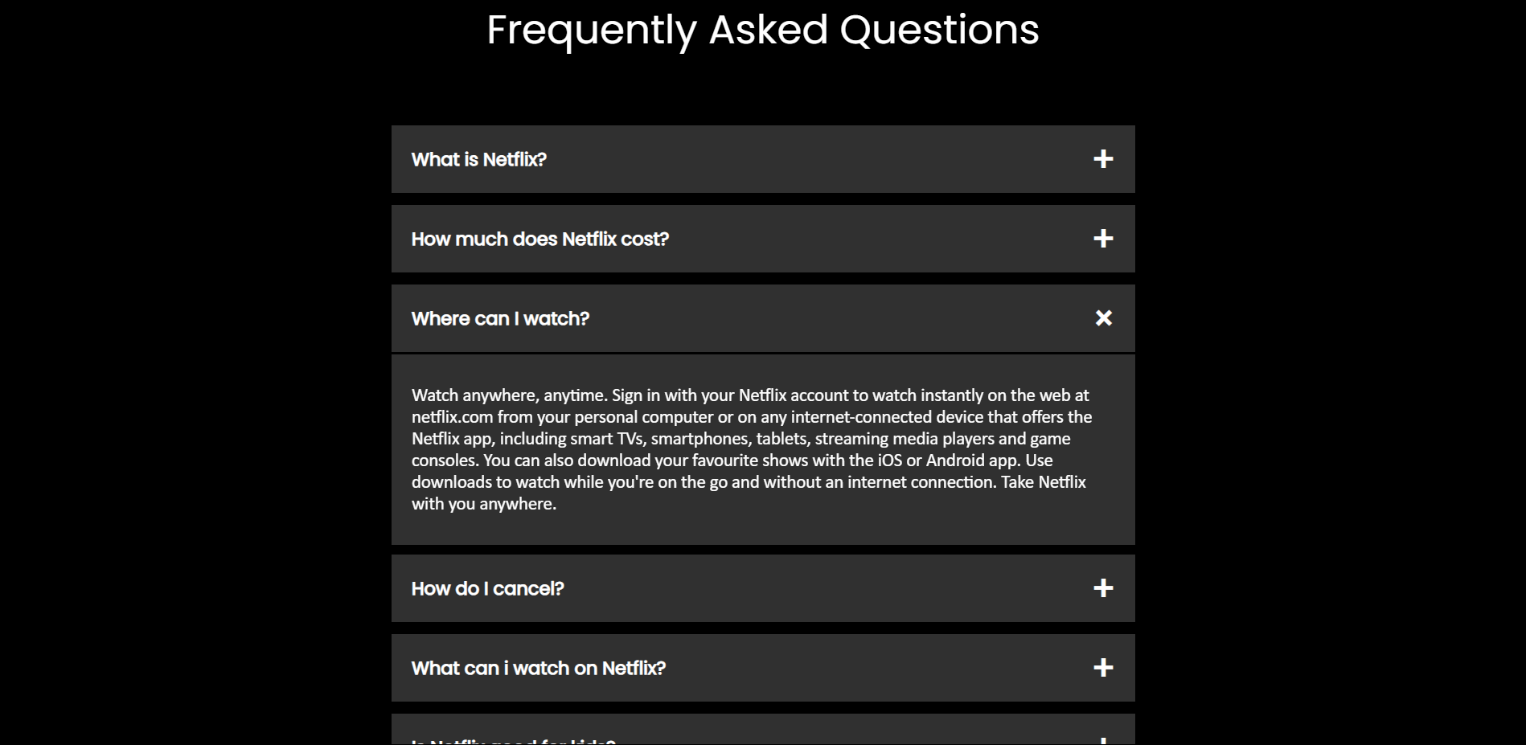
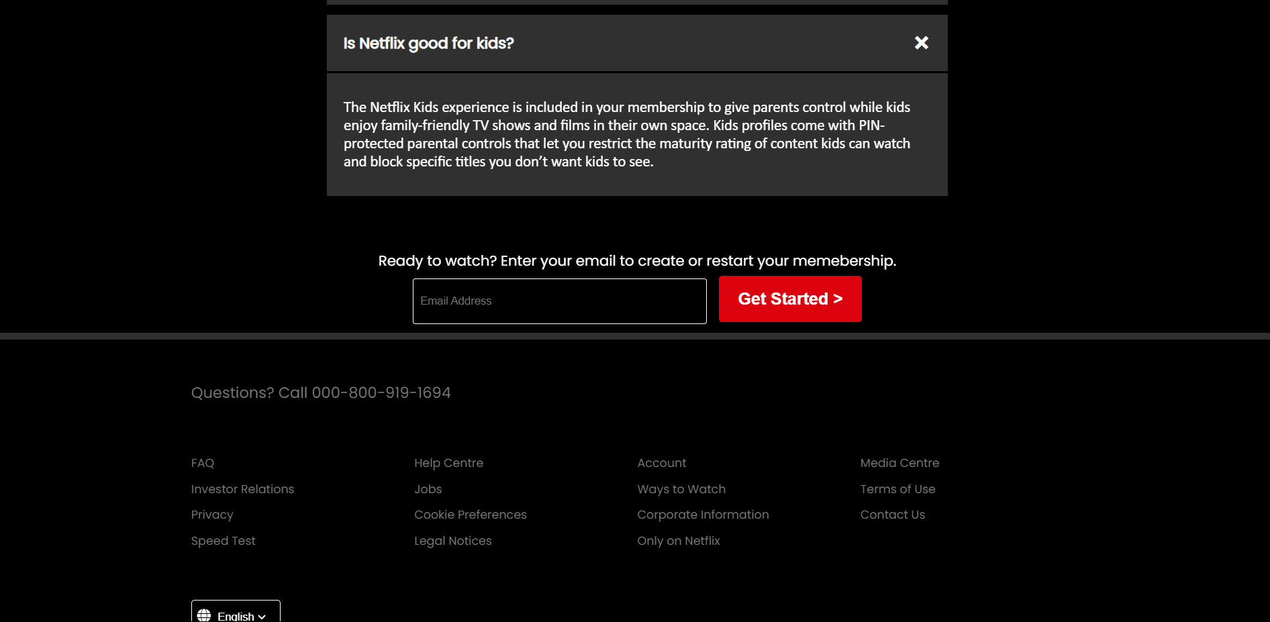
Results
The Netflix home or signup page serves as the gateway to the streaming platform, providing an engaging and user-friendly interface that encourages visitors to explore and subscribe. The homepage typically features visually striking elements, such as dynamic backgrounds showcasing popular shows and movies, enticing promotional offers, and clear calls-to-action. The signup page streamlines the registration process with easy-to-follow steps, social media integration, and secure authentication measures. Designed for accessibility and responsiveness, the page ensures a smooth experience across various devices. By combining appealing visuals with intuitive navigation and robust security, Netflix effectively attracts and converts visitors into loyal subscribers.

Slide 10
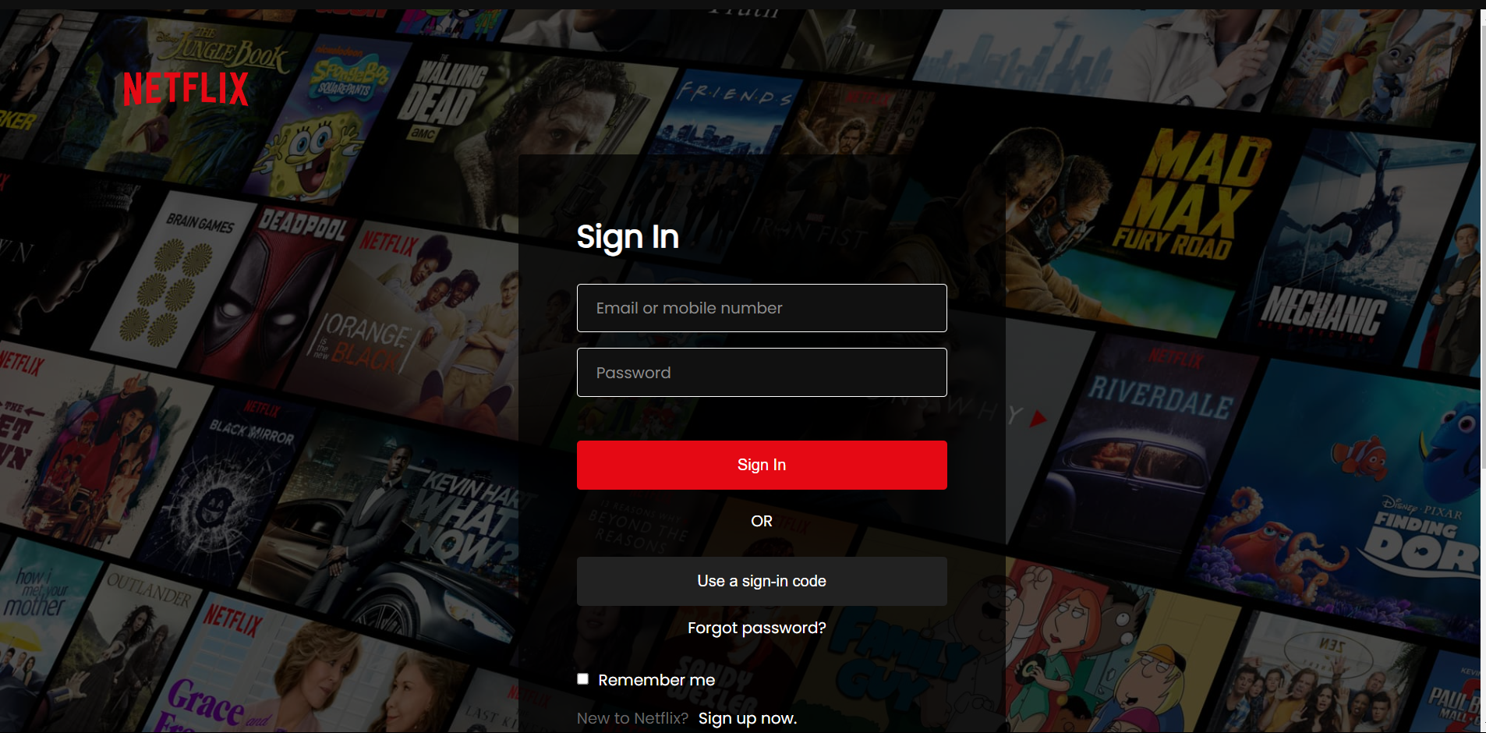
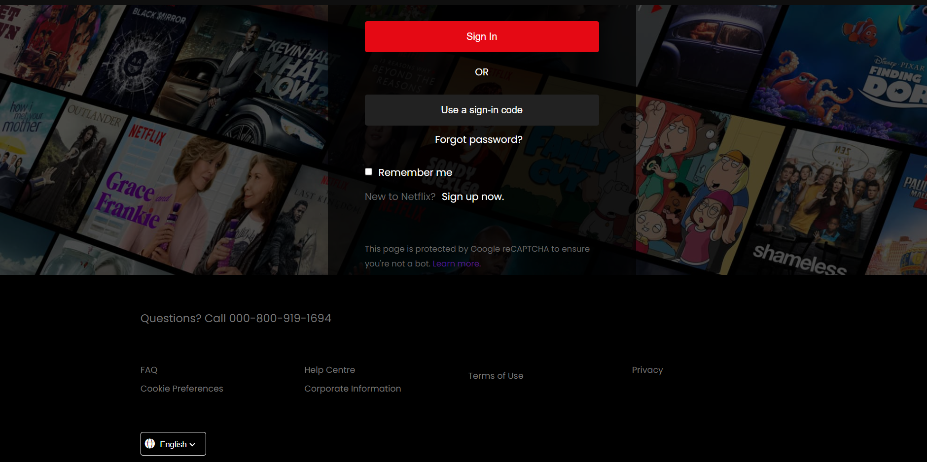
Results
The Netflix sign-in page is designed to provide users with a quick and secure entry point to access their accounts and enjoy the streaming service. It features a clean and straightforward interface with fields for entering email or phone number and password, ensuring ease of use. The page also includes options for password recovery and multi-factor authentication to enhance security. For added convenience, users can choose to stay signed in on their devices. With a focus on simplicity, security, and user experience, the Netflix sign-in page ensures that subscribers can effortlessly access their favourite content anytime, anywhere.

Slide 11
links
GitHub Link: https://github.com/MONDALaritra/CLONEWEB
Netflix Home page: https://www.netflix.com/in/
Netflix Login Page: https://www.netflix.com/login

